Slide 1
“I’m happy if you are happy." A model for emotional contagion in game characters
Joana Dimas, Gonçalo Pereira, Pedro A. Santos, Rui Prada, Ana Paiva
INESC-ID and IST

Slide 2
Outline
The Problem
Related Work
Introduction
How It Works
Experiment
Future Work
Conclusion

Slide 3
Introducing the Problem
Characters in games could be more believable
How?
Giving Characters Emotion

Slide 4
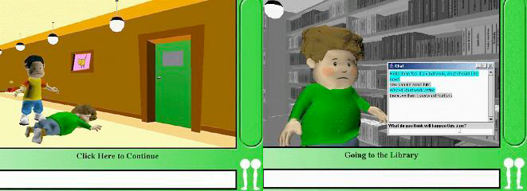
Related Work: FearNot!
A Virtual Drama concerning anti-bullying education
The emotion disposition of the virtual character affects the character’s motivations, priorities, and relationships

Slide 5
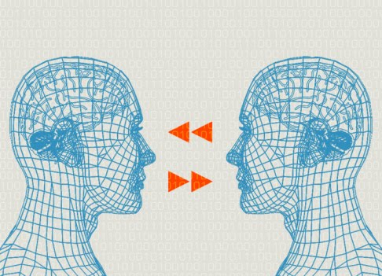
Related Work: Agent-Based Modeling of Emotion Contagion in Groups
A simulation for avoiding negative spirals in workgroups
The focus is
identifying
and prevention

Slide 6
But what these past works do not address is…

Slide 7


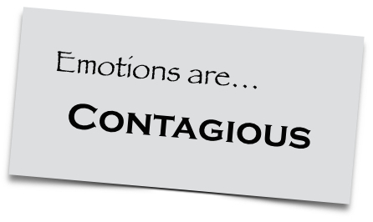
Emotional contagion in games

Slide 8
Introduction
“More believable social interactions between characters in computer games” (2)
Susceptibility to emotions from other characters especially in consideration of interpersonal relationships

Slide 9
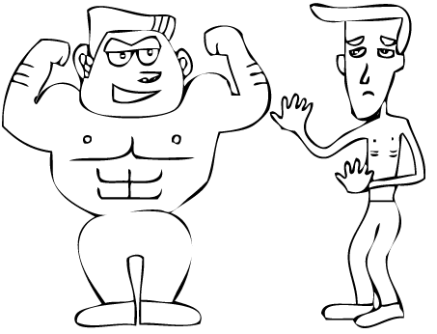

Introduction Cont.
Emotion Contagion is affected by:
Intimacy Level
Power Difference of Giver and Receiver

Slide 10
How it works
EE – Emotional Expression<t,i,o>
EE – Emotional Expression<t,i,o>
Contagion Filter
If Suscept(EE_{t})
Emotion<EE_{t},
Influence(EE_{i})>
Else
no emotion
Mood Updater
For all Emotion E in Current Mood
Update(E,ER)
Emotion Expression Filter
If rand(1) < ExpressionProb
EmotionalExpression <CE_{t},CE_{i},Self>
Else
no expression
RE - ReceivedEmotion<t,i>
CE - CurrentEmotion<t,i>

Slide 11
Fundamental Concepts
Emotion
EE (Emotional Expression)
Mood
Relationship

Slide 12
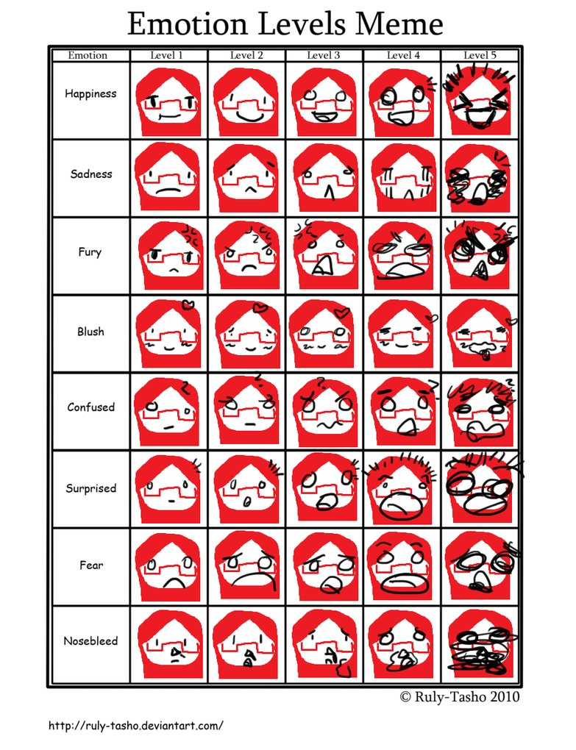
Emotion
Emotion : <t,i>
t = type of
emotion
i = intensity

Slide 13
Emotional Expression
EE (Emotional Expression): <t, i ,o>
t = type of emotion
i = intensity
o = transmitter of the expression

Slide 14
Mood
Mood <l,h,s,f,a> -
l = love
h = happiness
s = sadness
f = fear
a = anger

Slide 15
Relationship
Relationship <o, d, ri, rpd>
o = transmitter
d = target
ri = relationship intimacy
rpd = power difference

Slide 16
How it works
EE – Emotional Expression<t,i,o>
EE – Emotional Expression<t,i,o>
Contagion Filter
If Suscept(EE_{t})
Emotion<EE_{t},
Influence(EE_{i})>
Else
no emotion
Mood Updater
For all Emotion E in Current Mood
Update(E,ER)
Emotion Expression Filter
If rand(1) < ExpressionProb
EmotionalExpression <CE_{t},CE_{i},Self>
Else
no expression
RE - ReceivedEmotion<t,i>
CE - CurrentEmotion<t,i>

Slide 17
Emotional Expression Filtering
Determines whether the character will express its mood or not
Higher power position results in more expressiveness
Higher extroversion results in more expressiveness
Emotion Expression Filter
If rand(1) < ExpressionProb
EmotionalExpression <CE_{t},CE_{i},Self>
Else
no expression
CE - CurrentEmotion<t,i>
EE – Emotional Expression<t,i,o>

Slide 18
Contagion Filtering
Decides if the agent is affected by the received expression
Influenced by susceptibility, intimacy, and power difference
Contagion Filter
If Suscept(EE_{t})
Emotion<EE_{t},
Influence(EE_{i})>
Else
no emotion
RE - ReceivedEmotion<t,i>
EE – Emotional Expression<t,i,o>

Slide 19
Mood Updater
Combines the received emotion, the current mood, and the natural emotional status to calculate the next current mood
Mood Updater
For all Emotion E in Current Mood
Update(E,ER)
RE - ReceivedEmotion<t,i>
CE - CurrentEmotion<t,i>

Slide 20
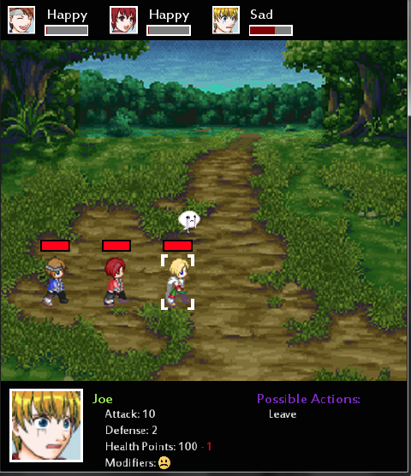
Game Description
Ben
Ace
(Control)
Joe

Slide 21


Character Qualities
3 Possible Actions
Open Treasure Chests
Talk to NPC
Use different attacks
when fighting monsters

Slide 22

4 Changing Stats
Health Points
Attack
Defense
Modifiers

Slide 23
5 Emotion with Capabilities
Happiness
Sadness
Love
Anger
Fear

Slide 24
Experiment Procedure
Participants have no prior knowledge
12 item Doherty Emotion Contagion Scale for Ace and Ben
4. Always = Always true for me
3. Often = Often true for me.
2. Rarely = Rarely true for me.
1. Never = Never true for me.

Slide 25
Doherty Emotion Scale
1. If someone I’m talking with begins to cry, I get teary-eyed.
2. Being with a happy person picks me up when I’m feeling down.
3. When someone smiles warmly at me, I smile back and feel warm inside.
4. I get filled with sorrow when people talk about the death of their loved ones.
5. I clench my jaws and my shoulders get tight when I see the angry faces on the news.
6. When I look into the eyes of the one I love, my mind is filled with thoughts of romance.

Slide 26
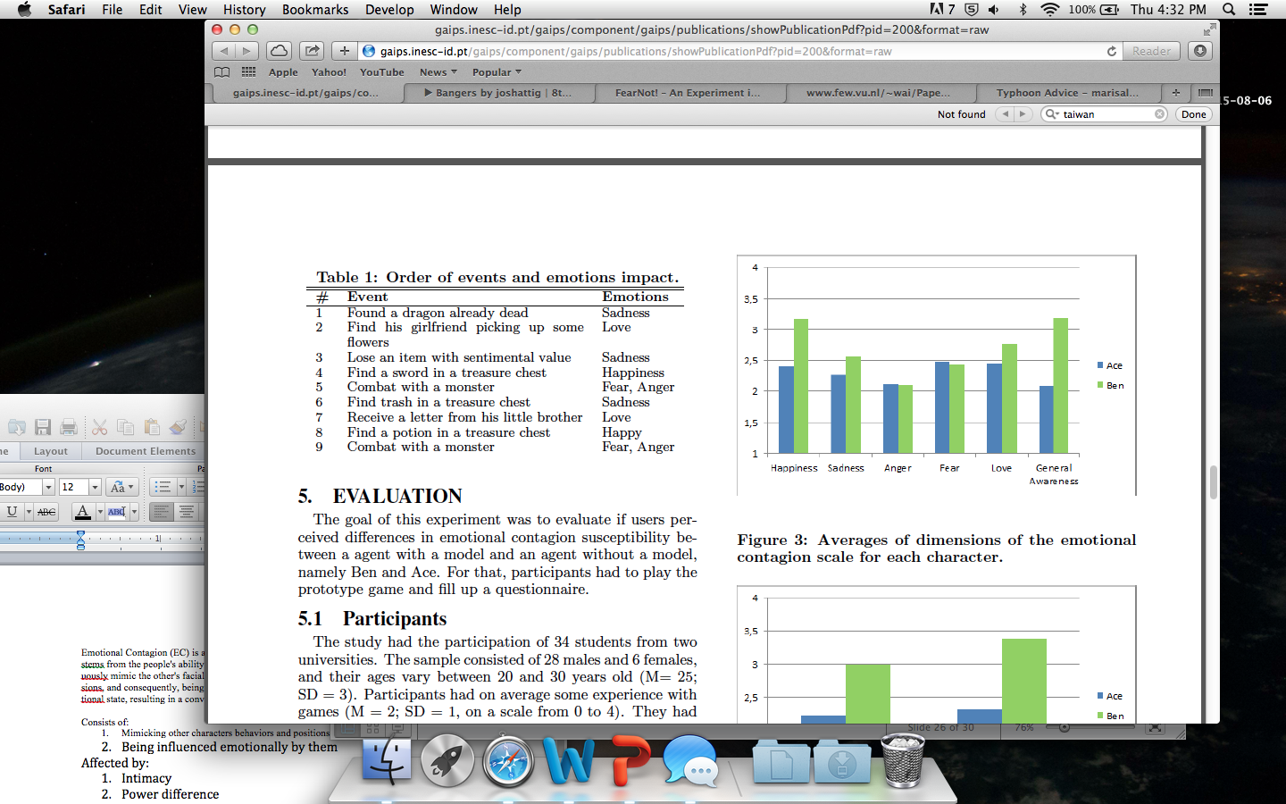
Results

Slide 27
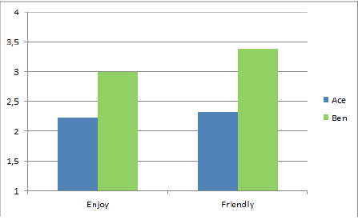
Results

Slide 28
Future Work
Further tests to see if emotion contagion can be observed by users

Slide 29
Conclusion
This is a basic model for Emotional Contagion in respect to relationships between characters and their different personalities
Users are able to recognize the emotional contagion for Happiness, Sadness, and Love
Users rated Ben as more enjoyable and friendly

Slide 30
Resources
R. Aylett, S. Louchart, J. Dias, A. Paiva, and M. Vala. FearNot!-an experiment in emergent narrative. In Intelligent Virtual Agents, pages 305-316. Springer, 2005.
T. Bosse, R. Duell, Z. Memon, J. Treur, and C. van der Wal. A Multi-agent Model for Emotion Contagion Spirals Integrated within a Supporting Ambient Agent Model. Principles of Practice in Multi-Agent Systems, pages 48-67, 2009.

Slide 31
Equations (Expressive)
apd = sum of all relationships pd/N
Biased Exp = ie + apd*(1-ie)*e_range
Expression Prob = BiasedExp, if BiasedExmp >= 0 = 0 is BiasedExp < 0

Slide 32
Equations (Contagion)
Suscept(EE) = true if rnd(1) <= ECS(EE)
= false if rnd(1) > ECS(EE)
Influence(EE) = EE(1+i_range * ri + p_range * rpd)

Slide 33
Equations (Mood)
For all Emotions E in Mood( l, h, s, f, a )
Upd(E,ER) = (Ei = ei + ER) if Et = Ert)
= (Ei = Decay(Ei, DM) otherwise )

